Slide 1
Gesture Recognition System
TS- AIML CAPSTONE PROJECT
Presented By:
1. Miss Poonam Salbande – GEC Avasari (TE Computer)
2. Miss Prachi Bhosale– GEC Avasari (TE Computer)
3. Miss Sakshi Taware – GEC Avasari (TE Computer)
4. Miss Pradnya Kulkarni – GEC Avasari (TE Computer)
5. Miss Pratiksha Ghophane - GEC Avasari(TE Computer)
Guided By: Mukta Raut Mam

Slide 2
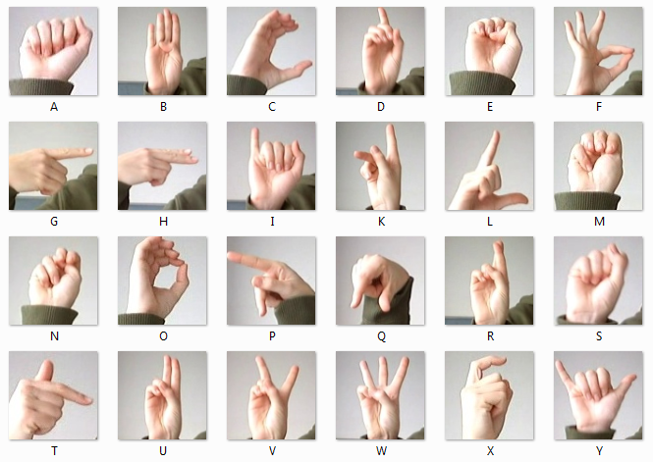
Contents
Problem Statement
Proposed System/Solution
System Architecture
Technologies Used
Future Scope
Conclusion
References

Slide 3
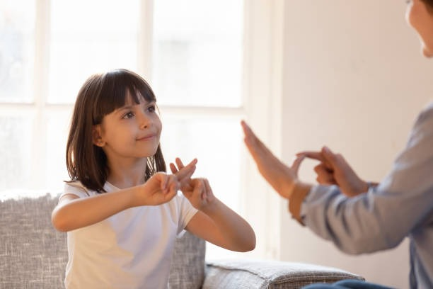
Problem Statement
Interactive presentation systems use advanced human computer interaction to provide more convenient and user-friendly interface and it can improved by hand gesture recognition.
Normal people cannot interact with deaf people because they are unable to understand their hand gestures which results in communication gap between them.

Slide 4
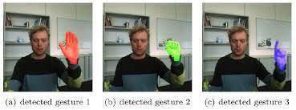
Proposed Solution
We are designing a application which uses a web-camera as a input device for capturing the coloured-images of 28 X 28 pixels.
By using Open CV, image is converted to grey-scale which is further analyzed and further classified by using CNN(convolution neural network).
After image processing our model predicts the gesture that we present in front of web camera.

Slide 5
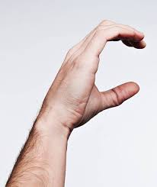
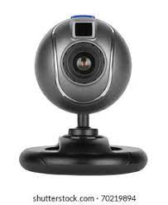
System Architecture
Image Processing
C
Store Captured Image
Predict Output
Hand Gesture
Web Cam
Output
Processing Unit

Slide 6
System Requirements
Hardware | Software
Operating System : Windows 10 8 GB RAM Web-camera | Anaconda Jupiter notebook Google Colab Python IDE- version 3.9.13

Slide 7
Future Scope
The proposed system reduce the working of external interface like keyboard and mouse so it makes it high portable.
By using this system, Deaf people will able to easily communicate, interact with others and can express their thoughts.
System will recognize the gestures of deaf people, and interpret it in human voice.

Slide 8
Conclusion
The proposed work will help to eliminate traditional complexities in communication between hearing impaired and normal person with the help of deep learning and machine learning approach.
It only require web-camera to capture I/P image. This would lead to new generation of human computer interaction in which no physical contact with device is needed.
Anyone can use the system to operate the computer easily by using gesture command.

Slide 9
References
J. Triesch and C. von der Malsburg, Robust classification of hand postures against complex backgrounds, In Proceedings of the IEEE, Int.Conference. On automatic face and gesture recognition 2011.
O. Ben-Henia, S. Bouakaz, Utilisation de l’ACP pour la reconnaissance de geste 3D de la main, ORASIS-Congré des jeunes chercheurs en vision par ordinateur, May 2017.

Slide 10
THANK YOU

